Slide 1

EPOS Platform Training event at Early Career Scientific School 28 August 2025
Jan Michálek
Institute of Geophysics ASCR

Slide 2
EPOS Platform - training
Agenda:
14:00-14:15 Introduction of the EPOS ecosystem
14:15-14:30 Demonstration of EPOS Data Portal by following scientific user story
14:30-15:10 Hands-on training by following a scientific use case & feedback collection through an online form
15:10-15:20 Walk-through
15:20-15:30 Discussion

Slide 3
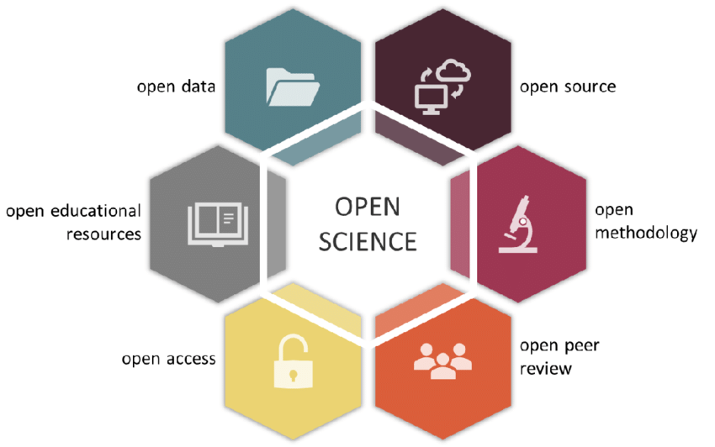
Gallagher, R.; Falster, D.; Maitner, B.; Salguero-Gómez, R; Vandvik, V.; Pearse, W.; Schneider, F.; Kattge, J. Alroy, J.; Ankenbrand, M.; Andrew, S.; Balk, M.; Bland, L.; Boyle, B.; Bravo Avila, C.; Brennan, I.; Carthey, A.; Catullo, R.; Cavazos, B.; Enquist, B.. (2019). The Open Traits Network: Using Open Science principles to accelerate trait-based science across the Tree of Life. 10.32942/osf.io/kac45.

Slide 4


Open Science: Benefits & barriers
Easier & timely access to data and scientific products
Verifiability
Reproducibility
Efficient use of research resources (no need to reinvent the wheel)
Open methodologies & algorithms
Different standards & vocabularies
Fragmentation
Communication between scientists and IT experts
Overhead needed to make the data open and FAIR
Intellectual Property Rights (perceived) issues
Legal and ethical issues

Slide 5





FAIR(R)
Findable
Accessible
Interoperable
Reusable
(machineReadable)
Notes:
OS and FAIR data management are generally presented together as the FAIR principles can be regarded as a tool to implement the OS vision- however the two concepts are not the same. All these principles, including the second “R” of machine-Readable are included in EPOS’ approach to data and scientific products

Slide 6

Open and FAIR RDM in EPOS
EPOS is bottom-up: scientific communities (the “TCS”) are at the very centre of our internal relations
Collaboration among the Scientific, IT and governance components has been a key for EPOS’ recipe to Open Science
Engagement of the communities has been crucial to harmonise data, processes and standards and to create an infrastructure that is scientifically relevant for the reference communities

Slide 7

MISSION: To establish a sustainable and long-term access to solid Earth science data and services integrating diverse European Research Infrastructures under a common federated framework

Slide 8
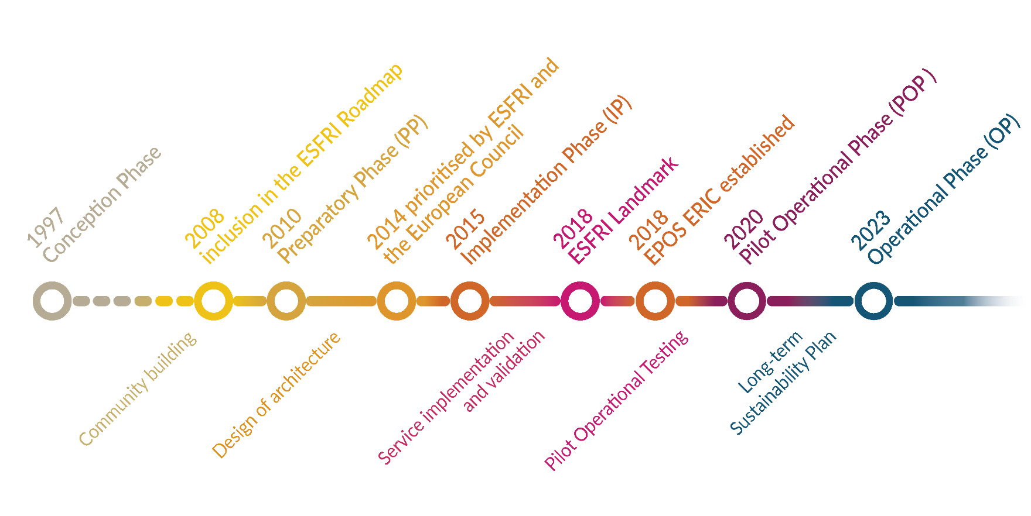
EPOS Timeline

Slide 9
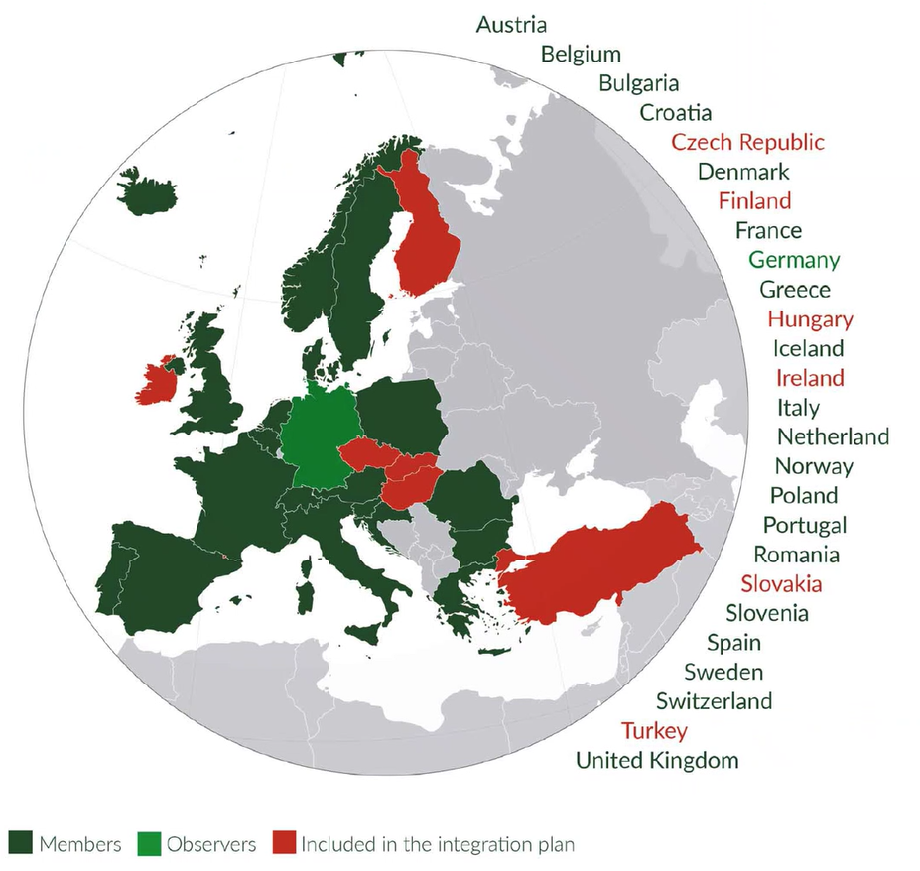
EPOS ERIC
Since October 2018, EPOS is an ERIC
European Research Infrastructure Consortium is a legal entity recognized in all EU Member States.
The principal task of an ERIC is to establish and operate a research infrastructure.

Slide 10
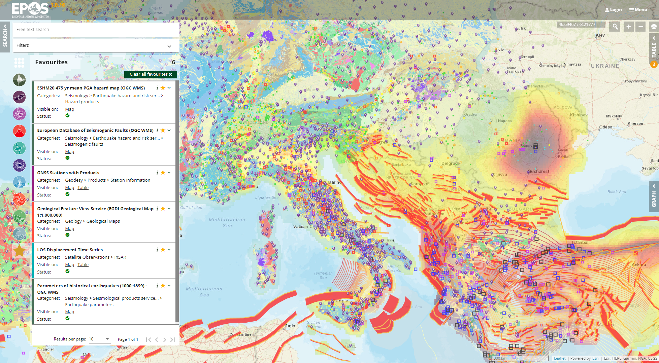




Service discovery, visualisation and data retrieval in the EPOS Platform
~ 400 Data and Service Providers ~ 300 Data Services
>800 Terabytes of Integrated Data
~ 180 weekly visitors
Icons created by Aranagraphics, catkuro, Becris and Prosymbols – Flaticon

Slide 11
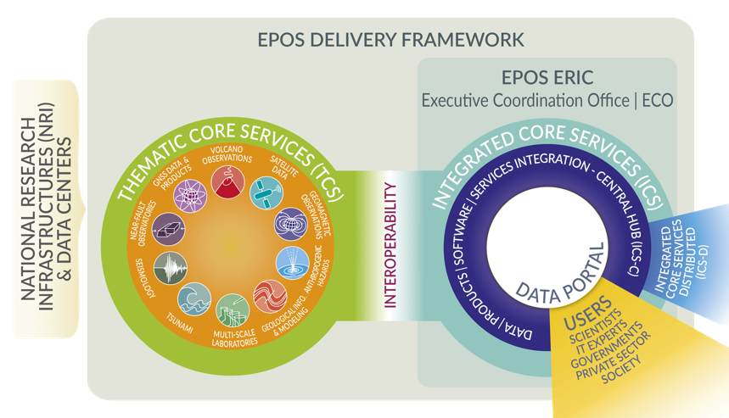

Slide 12
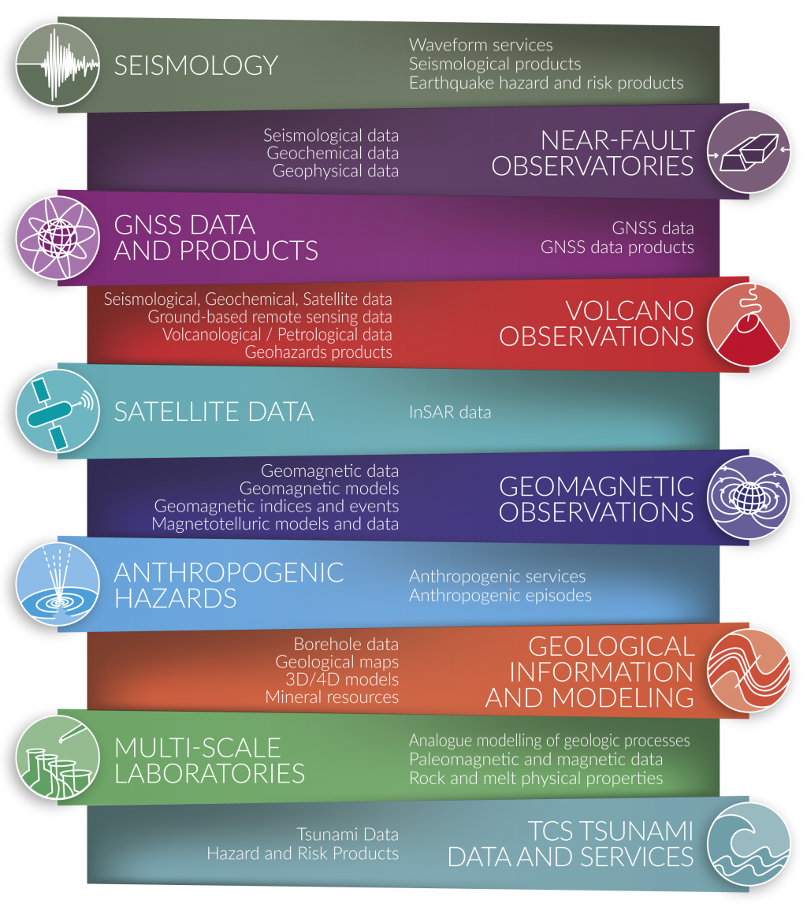
EPOS Thematic Core Services

Slide 13
EPOS Thematic Core Services

Slide 14
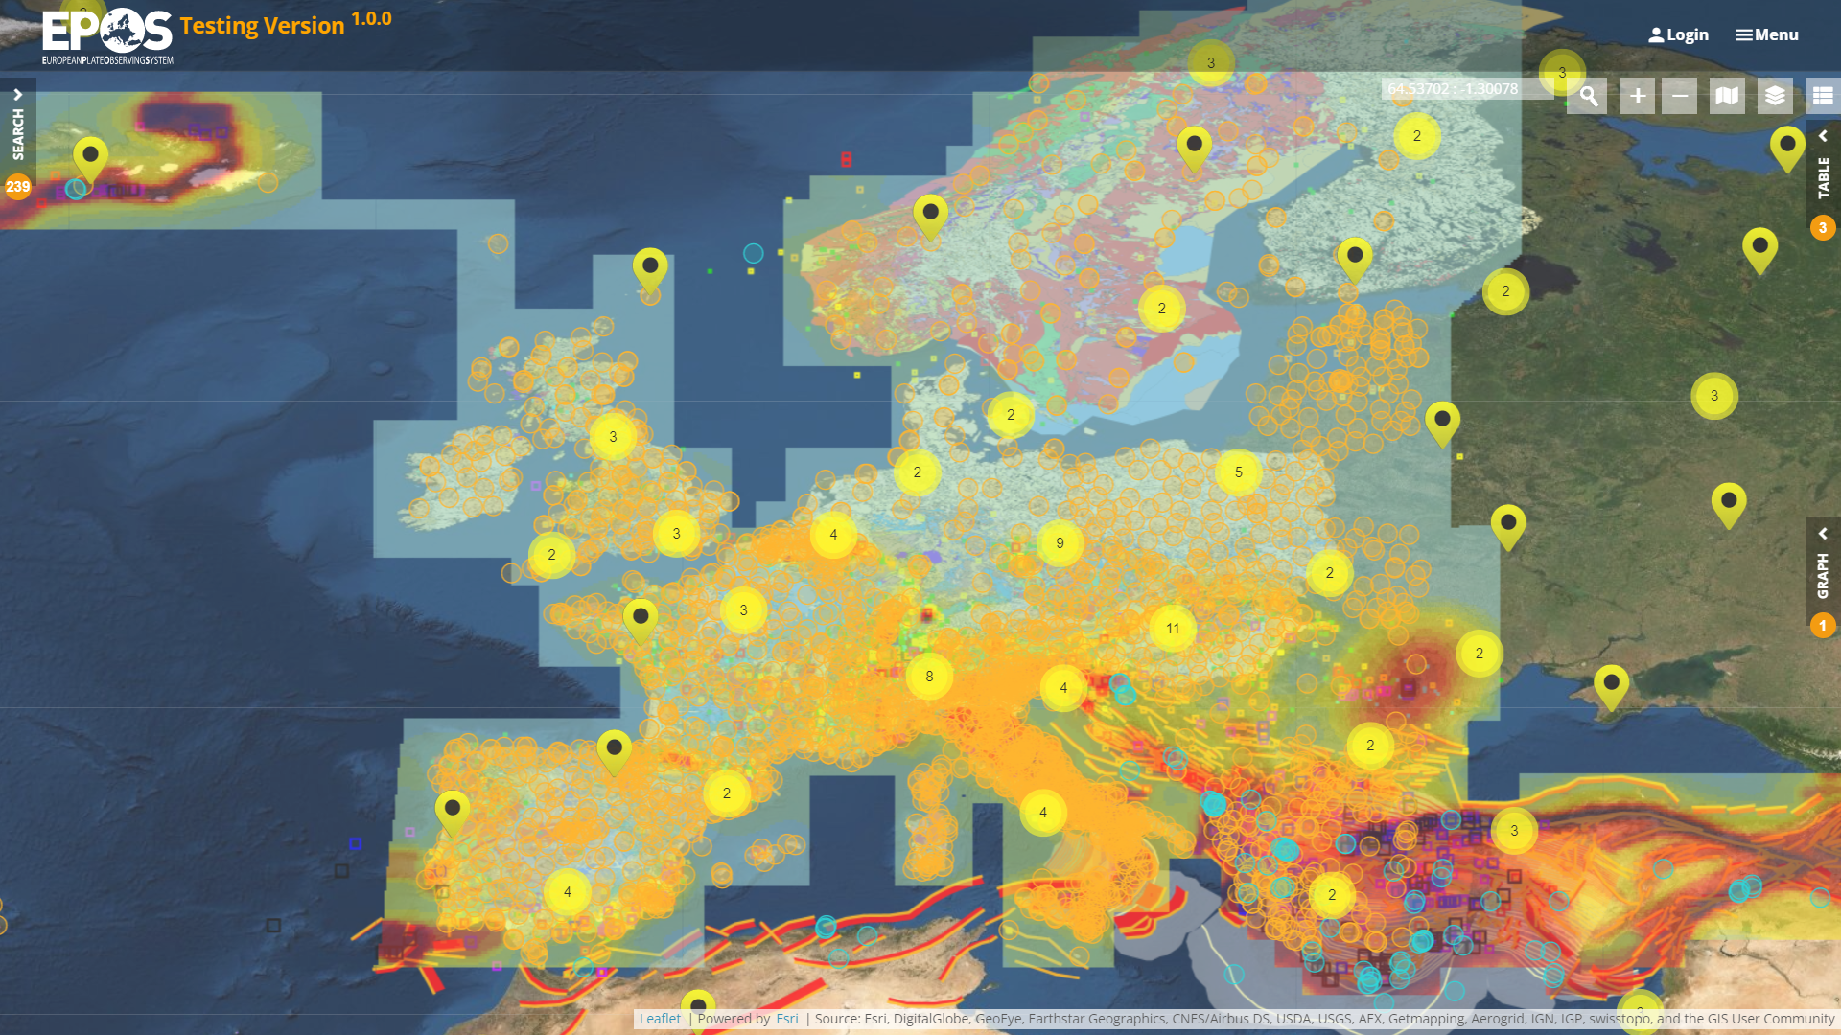








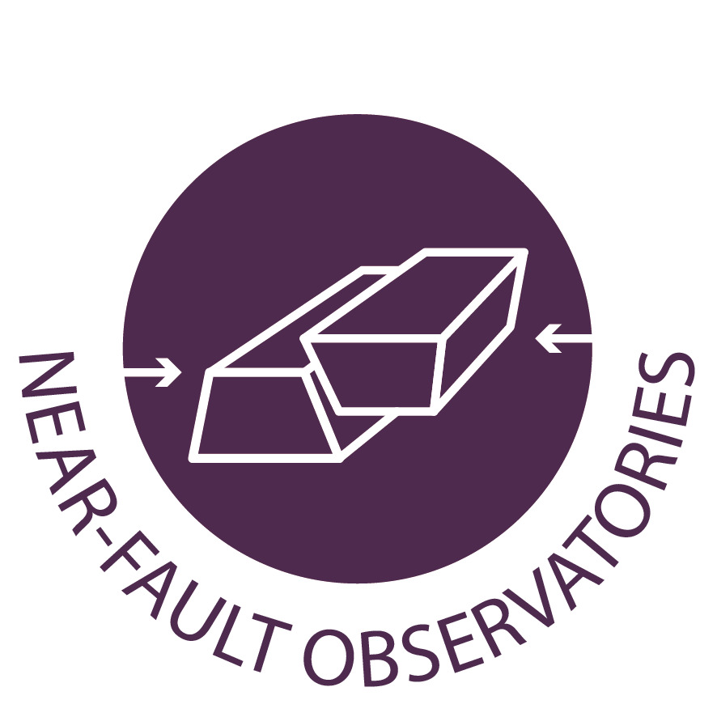


EPOS Technical Architecture
How it works …
GUI
ICS-D
ICS-C
INTEROPERABILITY
INTEROPERABILITY
TCS
TCS
TCS
TCS
TCS … Thematic Core Services
ICS … Integrated Core Services

Slide 15
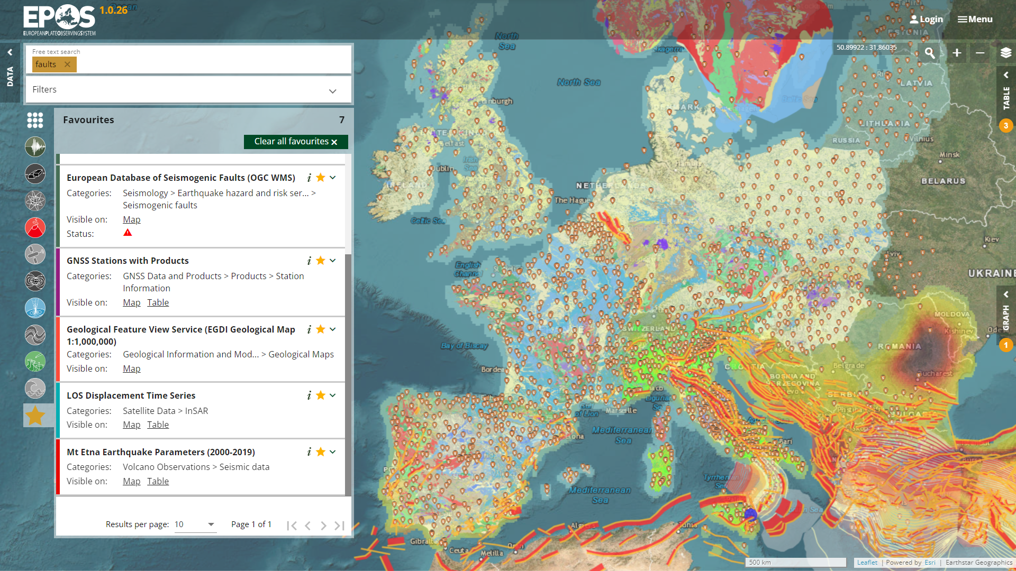
EPOS Platform is truly FAIR!
EPOS Platform is the place where FAIR principles and practices are implemented thanks to the adoption of a co-development approach and harmonization actions across communities of developers and data providers.
https://www.ics-c.epos-eu.org/

Slide 16
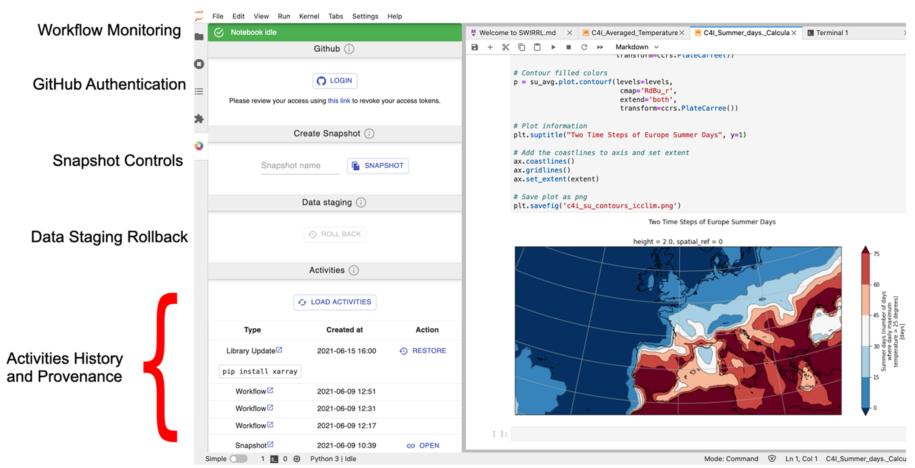
Jupyter Lab
Further developments – distributed services

Slide 17
EPOS Platform
Live demo

Slide 18
EPOS Platform
Link to hands-on training instructions:
bit.ly/ECSS-2025

Slide 19
Try it! ics-c.epos-eu.org

